Slide 1

Hacking in the 21st Century
Sidhardh Burre

Slide 2
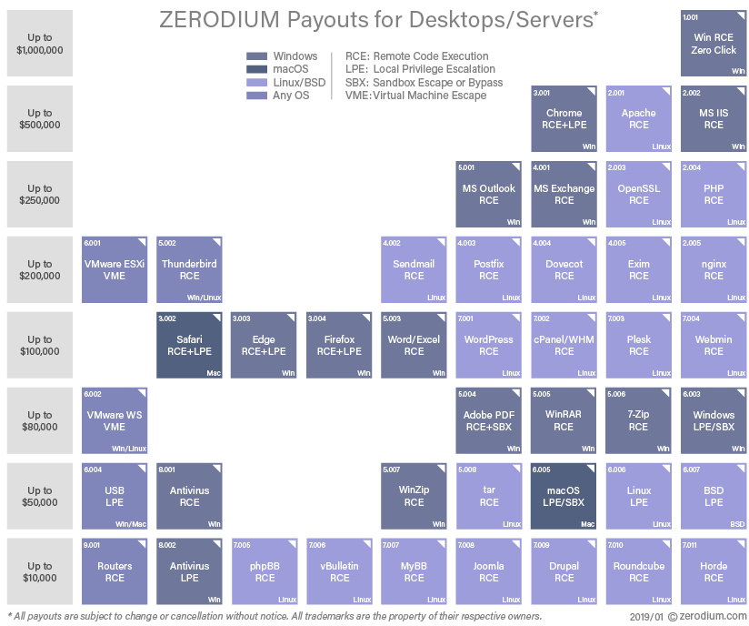
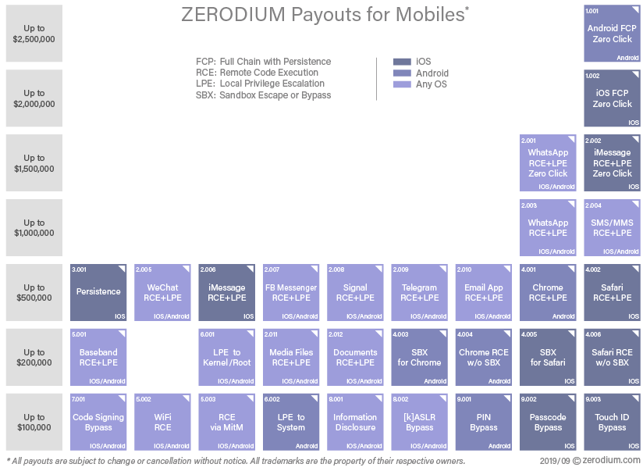

Slide 3
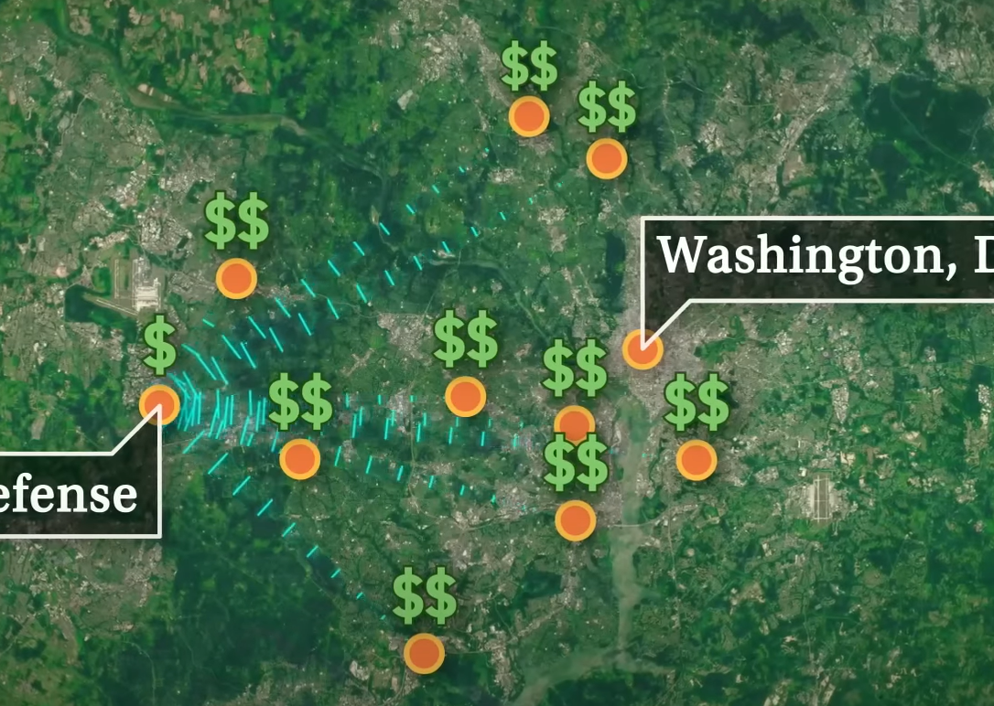
Secondary Market for Exploits
Exploits are essentially “hacks”
Private companies purchase them
Government agencies (and others) buy them second hand
for 10-100x the original price
have little to no traceability

Slide 4




Stuxnet
Used four exploits
.LNK exploit
2. Remote code exploit for network printers
Escalation of privilege zero day 1
Escalation of privilege zero day 2
Zero-day flaw in Siemens PLC
Conficker attack hole
What was it designed to do?
Notes:
One such weapon is STUXNET which used four unique exploits and infected 58% of Iranian computers. To attack its target, a hidden Iranian Nuclear Enrichment Facility, a usb drive infected with the malware was connected to a computer in the facility. From there, it used the Remmote code exploit for network printers to jump to all other computers in the network. But it waited patiently to attack a computer connected to a Siemens PLC, a controller for a uranium centrifuge. By varying rpms within the centrifuge, while reporting that the centrifuge was working properly, Stuxnet was able to damage the centrifuges. Destroying Iran’s nuclear ambitions in the process.

Slide 5
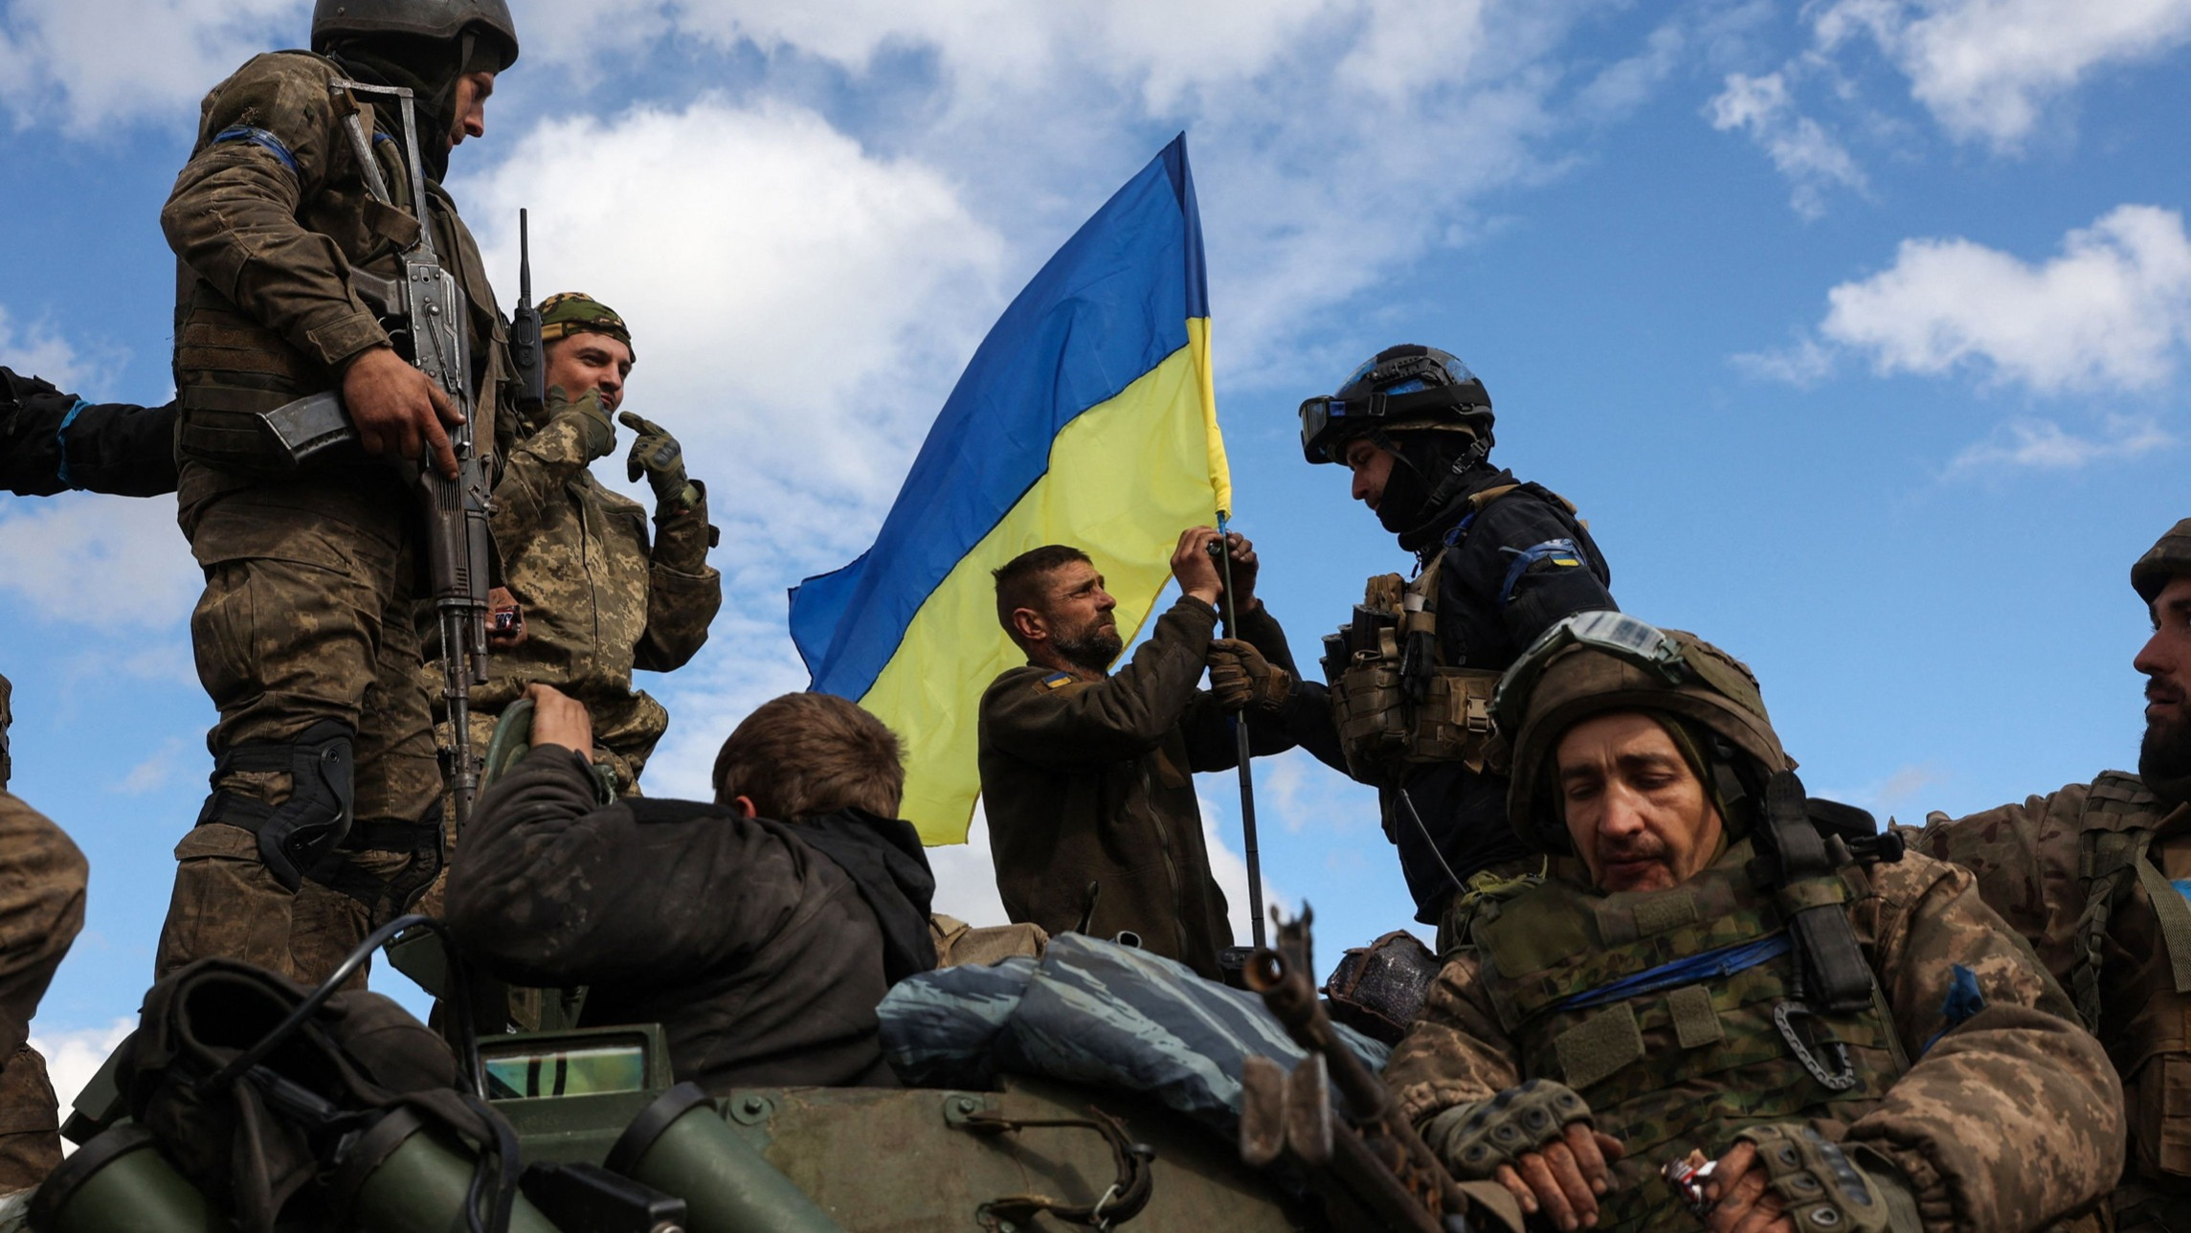
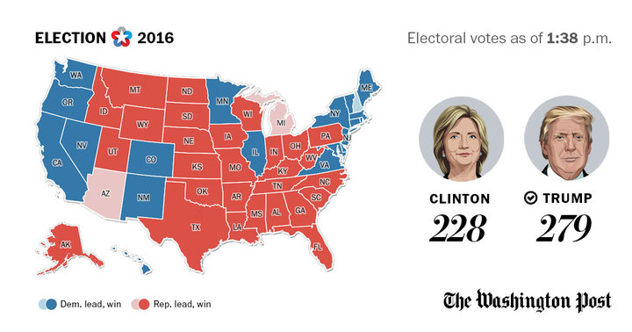
What does this mean for war?
War has completely changed
Hyper-efficient
Anonymous
Little to no oversight
Cyberwarfare capabilities
espionage
sabotage
propaganda
economic disruption
etc.

Slide 6
“…Napoleon won his victories because the Grand Army could outmarch the enemy. It is the same to-day. War never changes. Only weapons are new. Yet it is not always the weapons, but the men who handle them, who win victories.”
-“The Days Work of a Soldier” from The World’s work; Second War Manual; The Conduct of War (1914)

Slide 7
What does this mean for us?
Our capabilities for destruction have outstripped our abilities to understand them
Specify and follow rules of engagement
Apply intense scrutiny to companies/organizations/people that develop/research/disseminate enabling technologies
Contain civilian fallout

